Slide 1
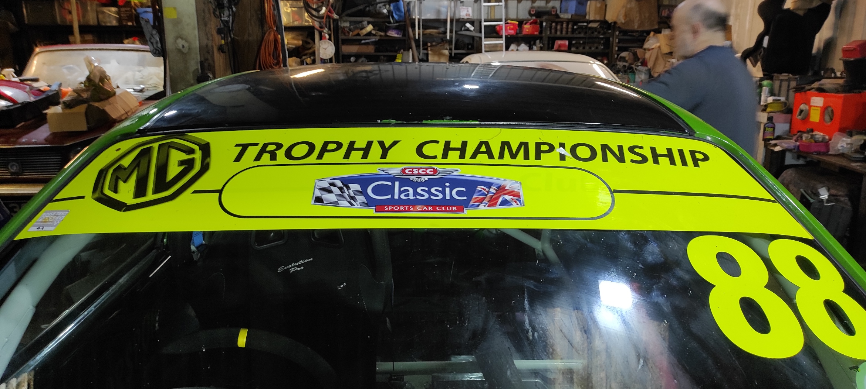
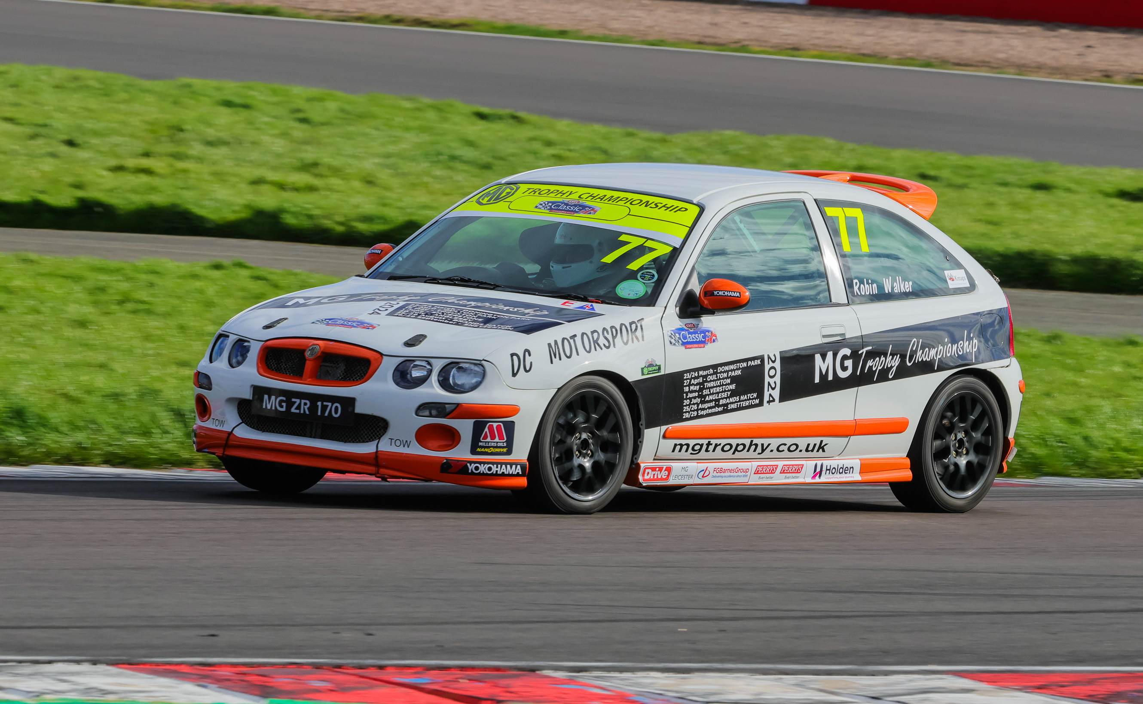
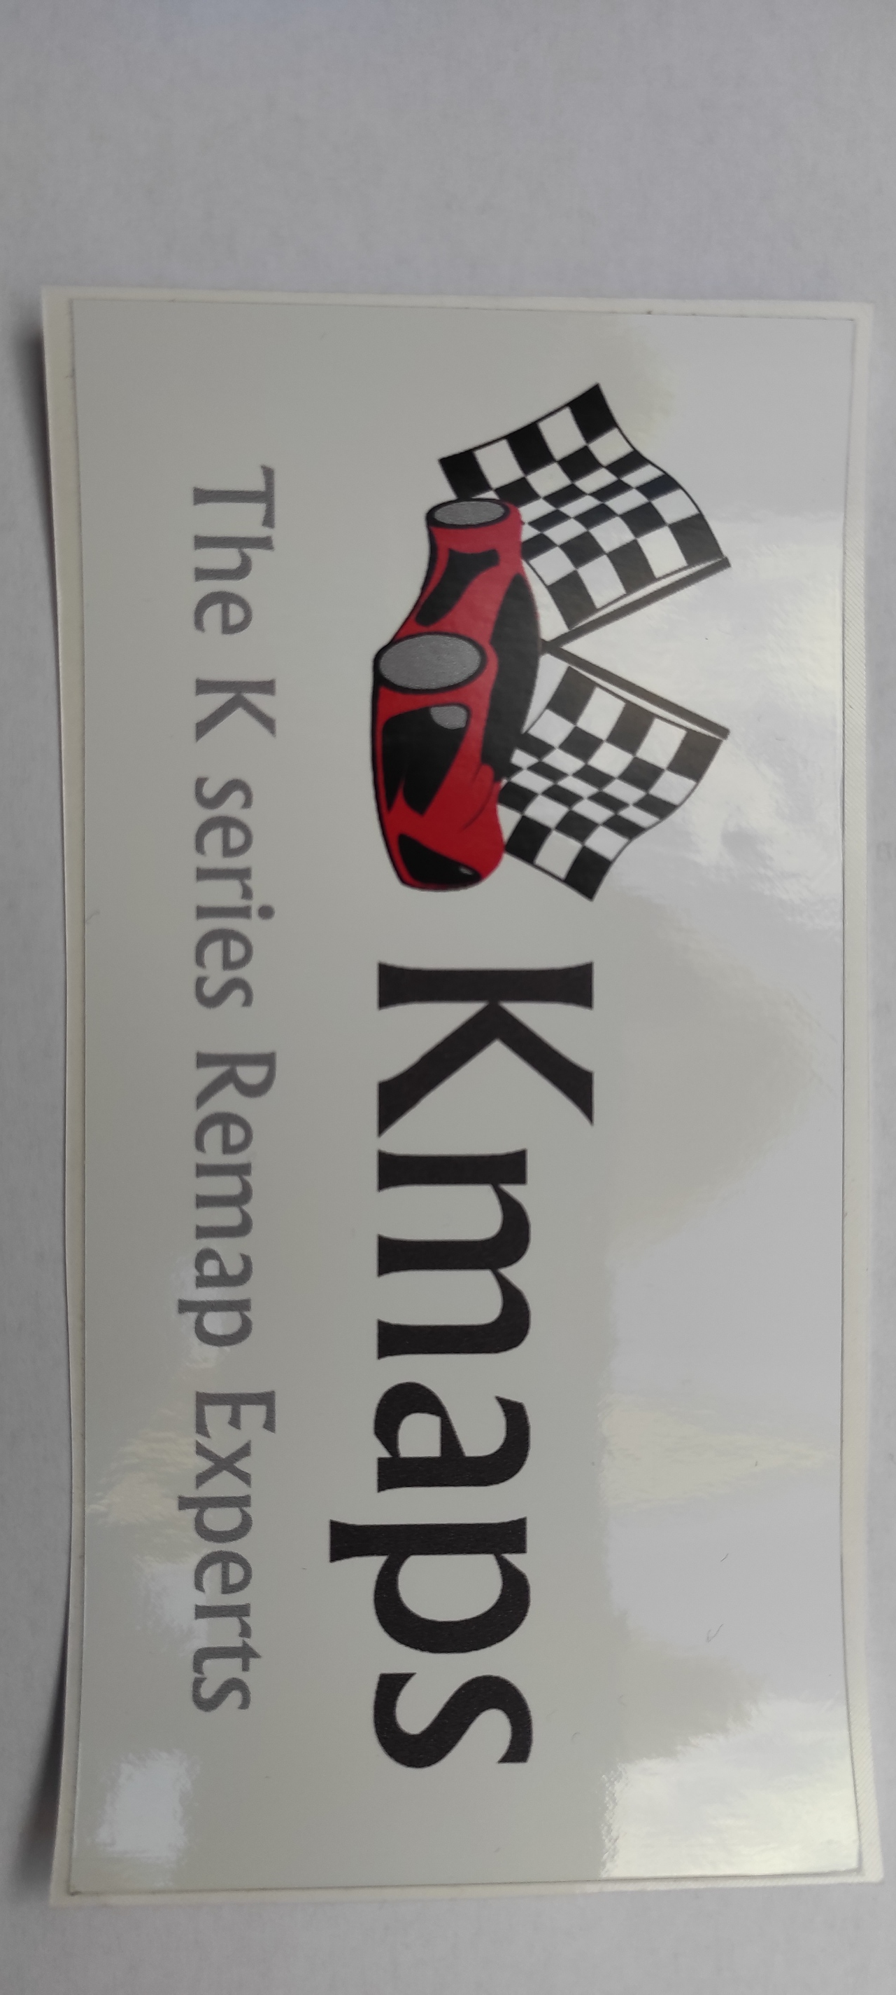
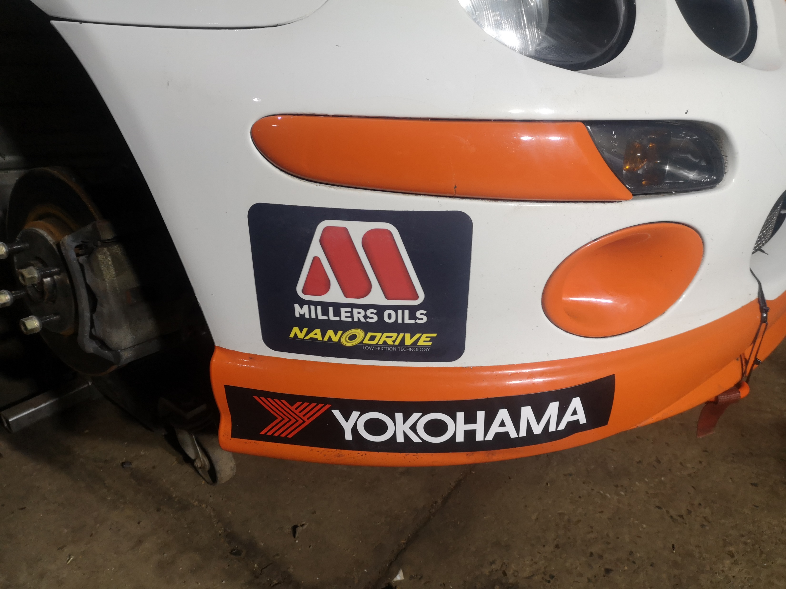
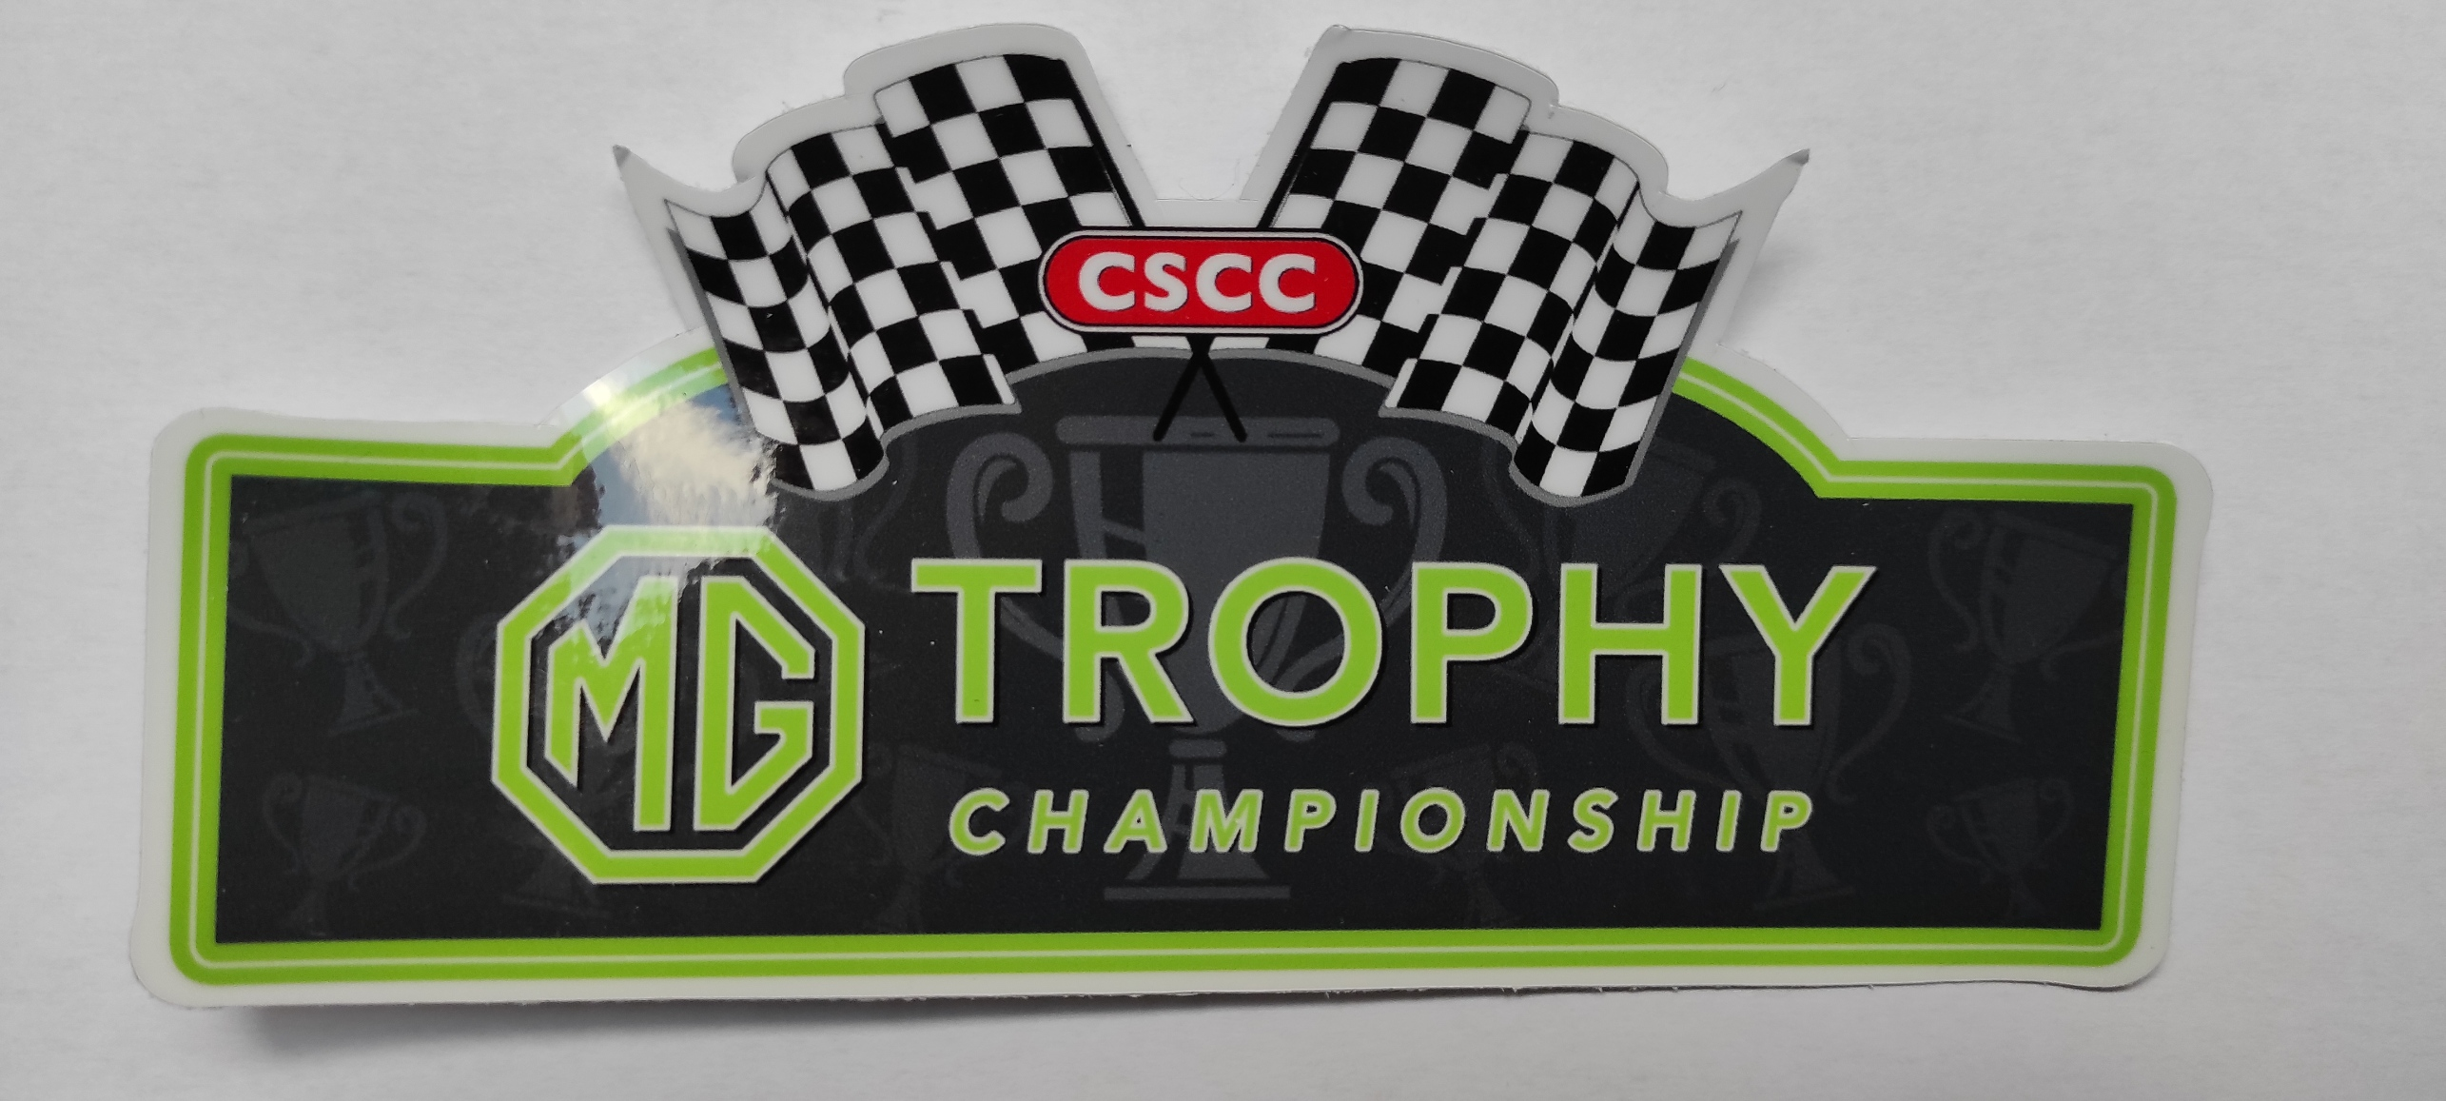
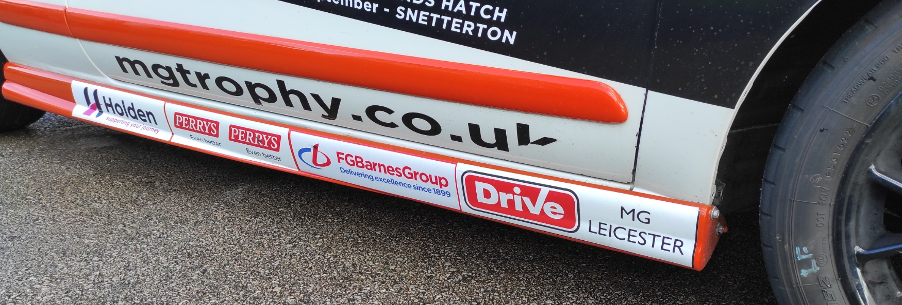
MG TROPHY STICKER POSITIONING GUIDE 2024
Name here using Myriad Pro bold font white, 50mm high along lower edge of ALL 3 rear windows
Orange Sunstrip 190, Yellow Sunstrip 170, White Sunstrip160
CSCC sticker on top to cover MG Car Club wording
Kmaps sticker here on both sides of car
CSCC sticker here on both sides of car
Autism Early Support Charity sticker here.
CSCC MG Trophy sticker here on both sides of car.
Millers & Yokohama stickers here on both sides
Race sponsor stickers here under rubbing strip or on sill on both sides
MG Trophy Sticker Positioning Guide (front) 2024 iss 1

