Slide 1
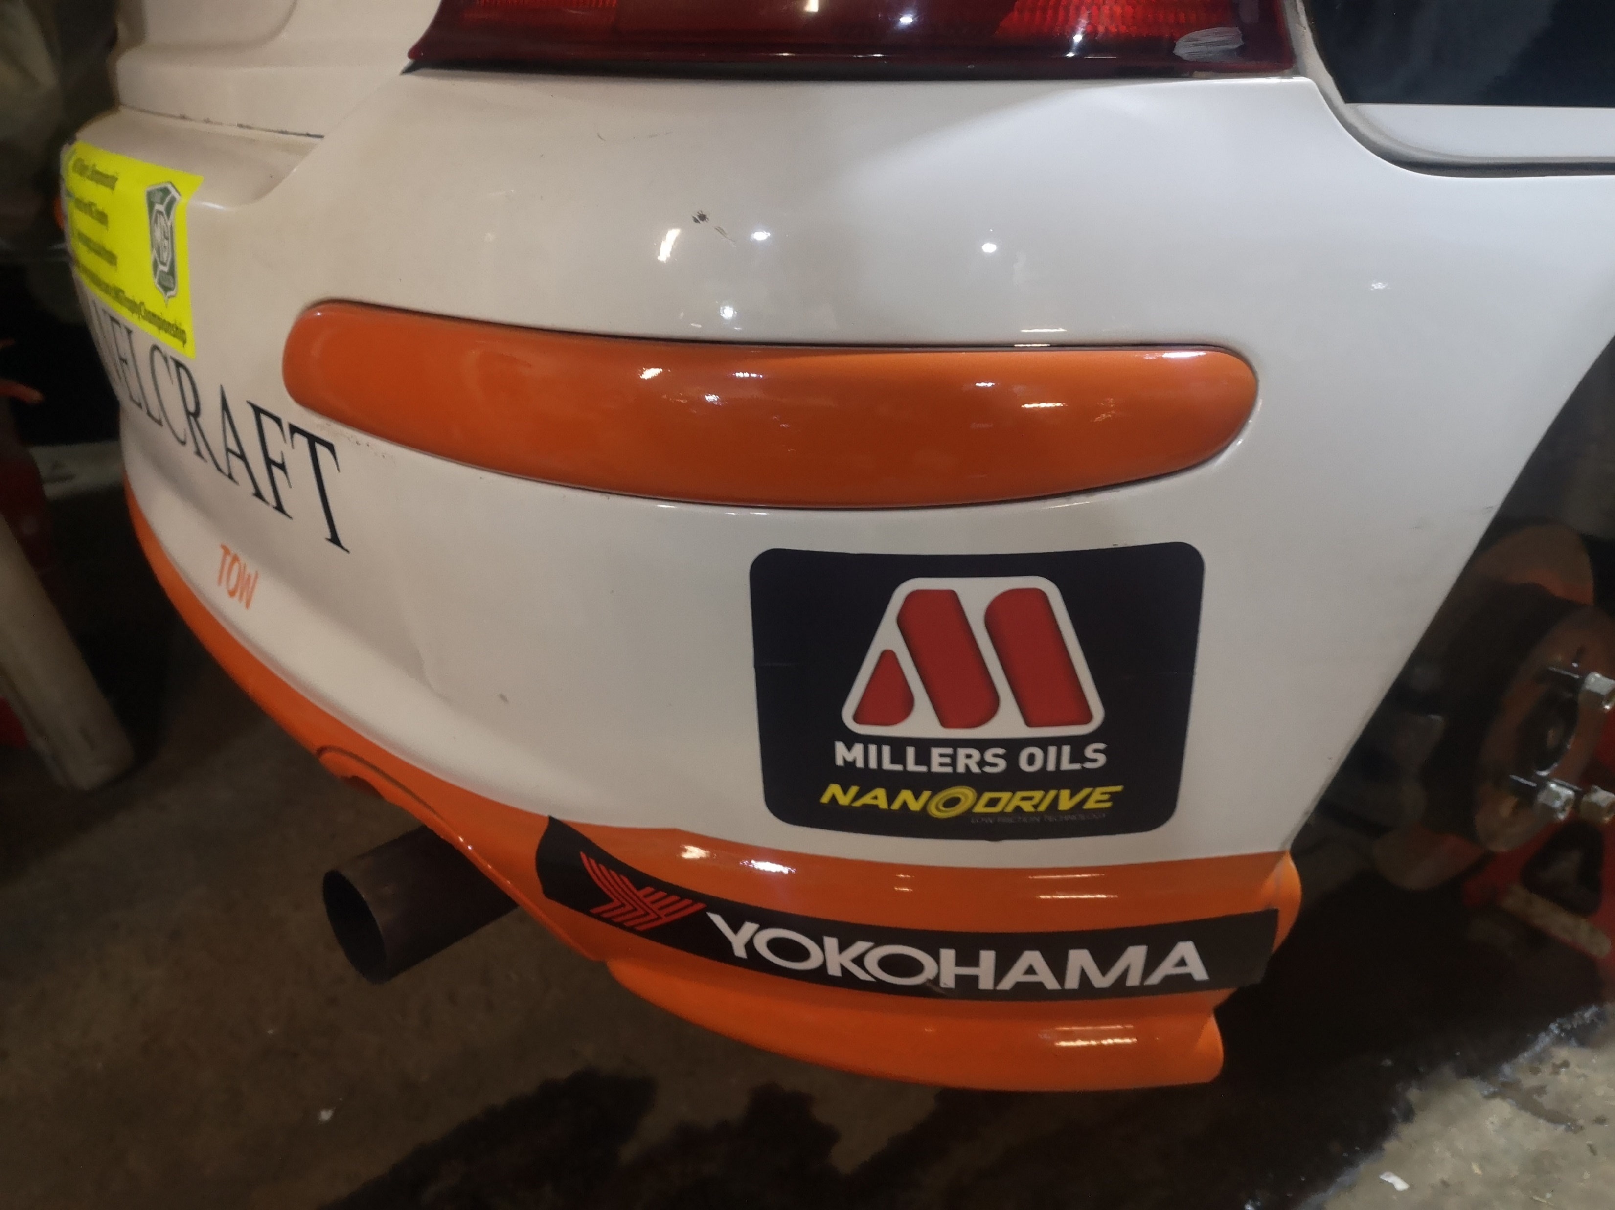
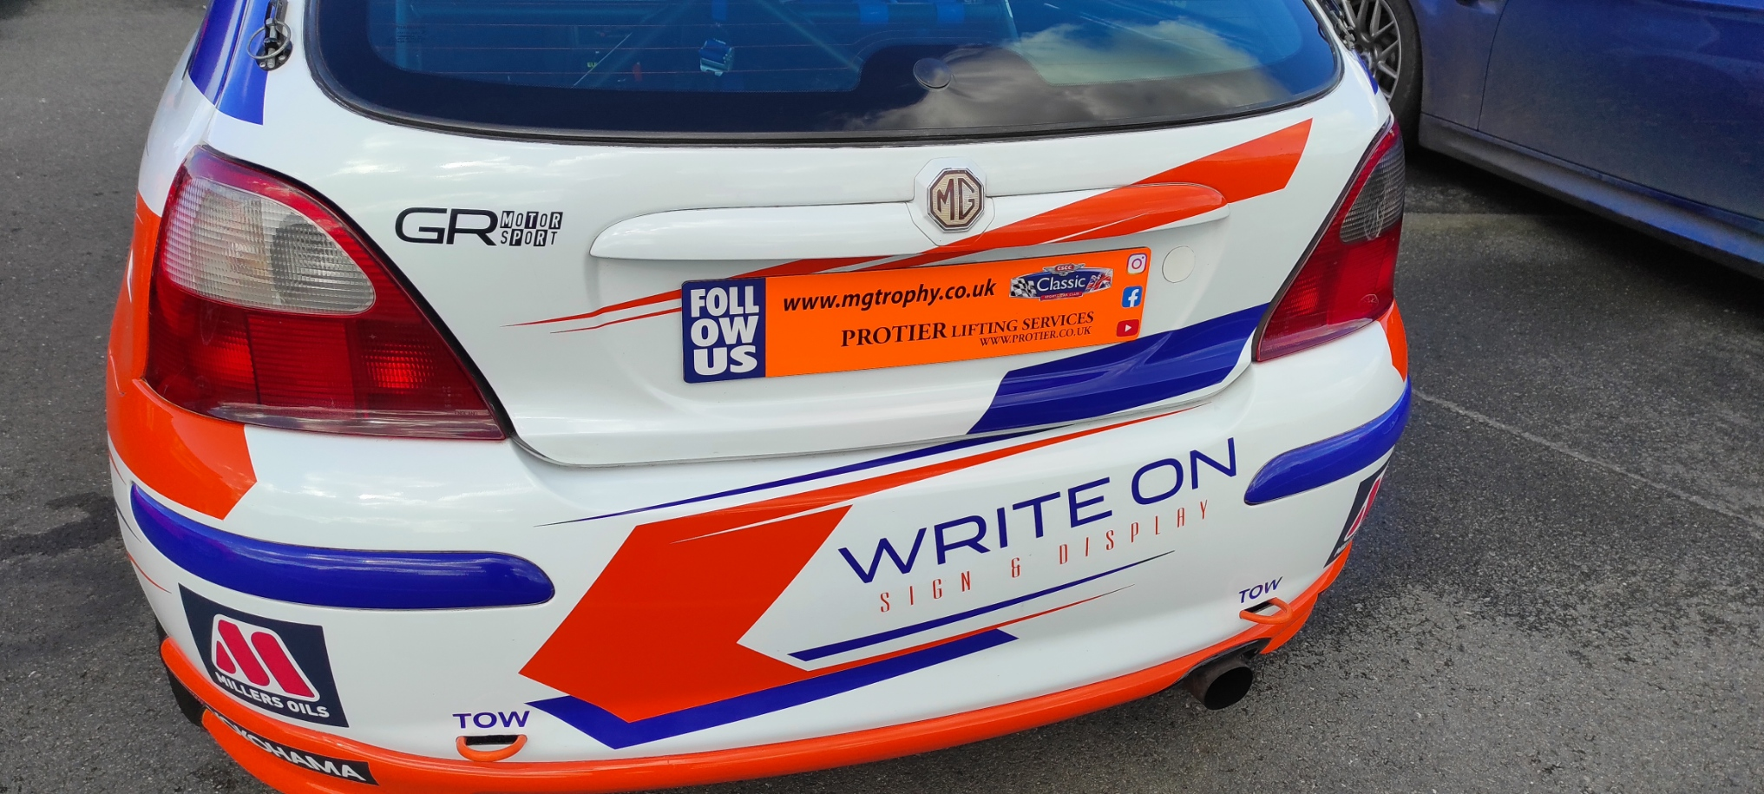
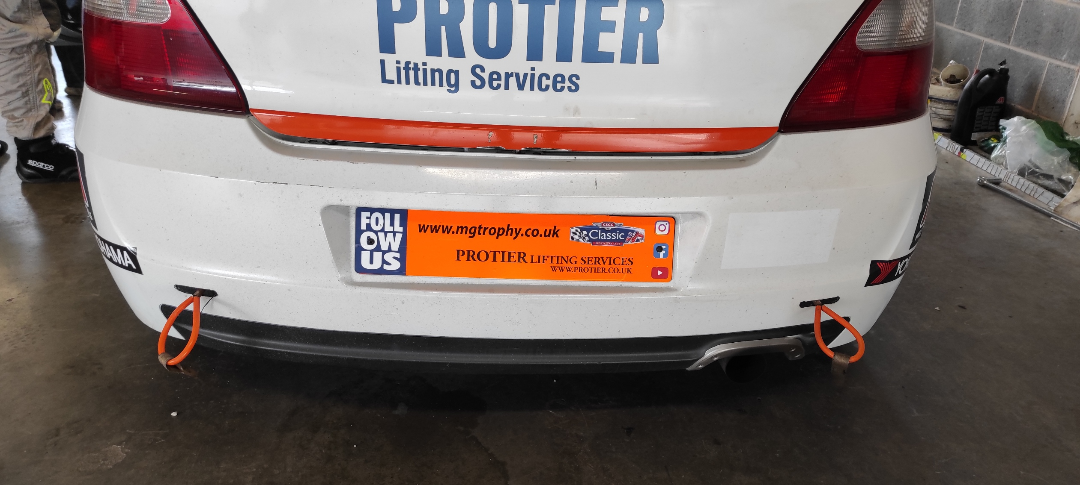
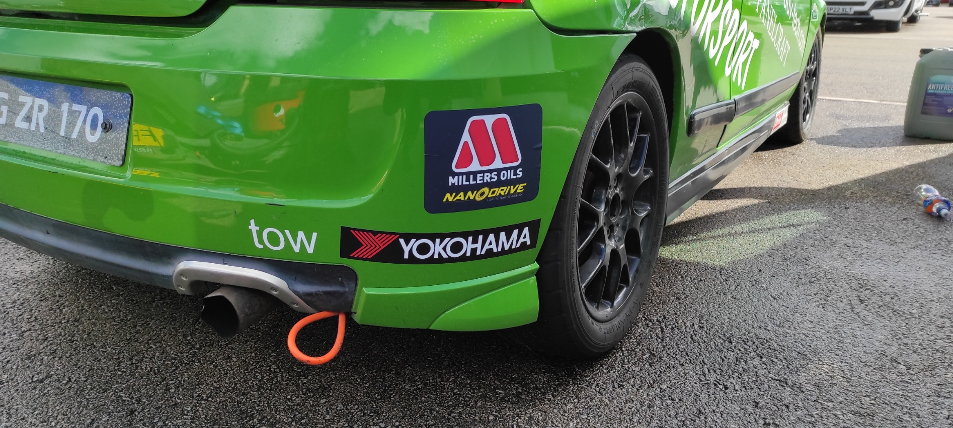
MG TROPHY STICKER POSITIONING GUIDE 2024 REAR
Millers & Yokohama sticker positions depending on body style
Protier media sticker positions depending on body style. Photos show Orange stickers for 190 cars. Yellow for 170, White for 160.
MG Trophy Sticker Positioning Guide 2024 (rear) iss 1

